Slide 1


Big Data Analytics & Machine Learning : GraphX
BIG DATA ANALYTICS & MACHINE LEARNING
DBRAIT-24/04/2019

Slide 2
Flight Data Analysis using Spark GraphX
Dataset Description:
The data has been collected from U.S. Department of Transportation's (DOT) Bureau of Transportation Statistics site which tracks the on-time performance of domestic flights operated by large air carriers. The Summary information on the number of on-time, delayed, canceled, and diverted flights is published in DOT's monthly Air Travel Consumer Report and in this dataset of January 2014 flight delays and cancellations.

Slide 3
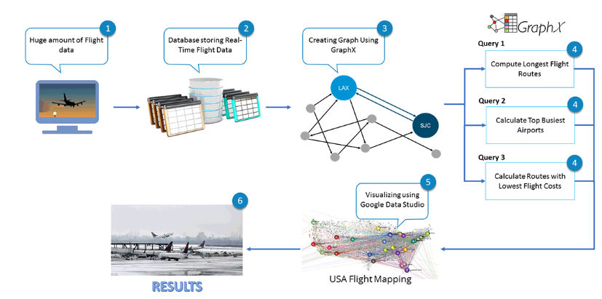
Big Data Pipeline for Flight Data Analysis using Spark GraphX

Slide 4
UseCases
Monitoring Air traffic at airports
Monitoring of flight delays
Analysis overall routes and airports
Analysis of routes and airports per airline

Slide 5
Objectives
Compute the total number of airports
Compute the total number of flight routes
Compute and sort the longest flight routes
Display the airports with the highest incoming flights
Display the airports with the highest outgoing flights
List the most important airports according to PageRank
List the routes with the lowest flight costs

Slide 6
Objectives
Display the airport codes with the lowest flight costs
List the routes with airport codes which have the lowest flight costs

Slide 7
Features
17 Attributes
Attribute Name | Attribute Description
dOfM | Day of Month
dOfW | Day of Week
carrier | Unique Airline Carrier Code
tailNum | Tail Number
fNum | Flight Number Reporting Airline
origin_id | Origin Airport Id
origin | Origin Airport
dest_id | Destination Airport Id
dest | Destination Airport
crsdepttime | CRS Departure Time (local time: hhmm)
deptime | Actual Departure Time

Slide 8
Features
Attribute Name | Attribute Description
depdelaymins | Difference in minutes between scheduled and actual departure time. Early departures set to 0.
crsarrtime | CRS Arrival Time (local time: hhmm)
arrtime | Actual Arrival Time (local time: hhmm)
arrdelaymins | Difference in minutes between scheduled and actual arrival time. Early arrivals set to 0.
crselapsedtime | CRS Elapsed Time of Flight, in Minutes
dist | Distance between airports (miles)

Slide 9
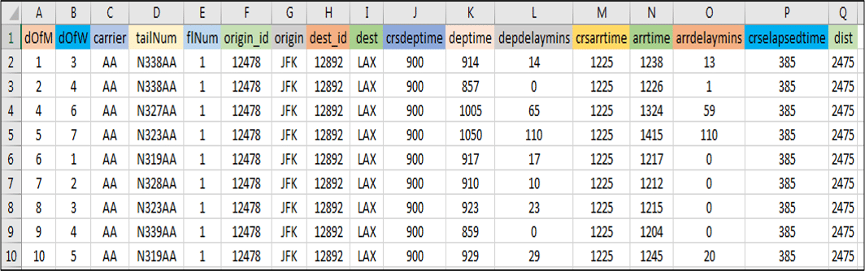
Sample Dataset

Slide 10
Creation of Property Graph
Loading the Dataset:
val textRDD = sc.textFile(“
/home/iitp/spark-2.2.0-bin-hadoop-2.6/flights/
rita2014jan.csv")

Slide 11
Creation of Property Graph
Vertices : Airports
val flightsRDD = textRDD.map(parseFlight).cache()
val airports =flightsRDD.map(flight => (flight.org_id, flight.origin)).distinct
VertexID | Property(V)
Id(Long) | Name(String)
Id | Property
12478 | JFK
12892 | LAX
11298 | DFW

Slide 12
Creation of Property Graph
Edges : Routes
val routes=flightsRDD.map(flight => ((flight.org_id, flight.dest_id), flight.dist)).distinct
// Defining the routes as edges
val edges = routes.map { case ((org_id, dest_id), distance) => Edge(org_id.toLong, dest_id.toLong, distance) }
SourceID | DestID | Property(E)
Id | Id | Distance (Integer)
SrcId | DestId | Property
12478 | 12892 | 2475
12892 | 11298 | 1235
11298 | 12478 | 1391

Slide 13
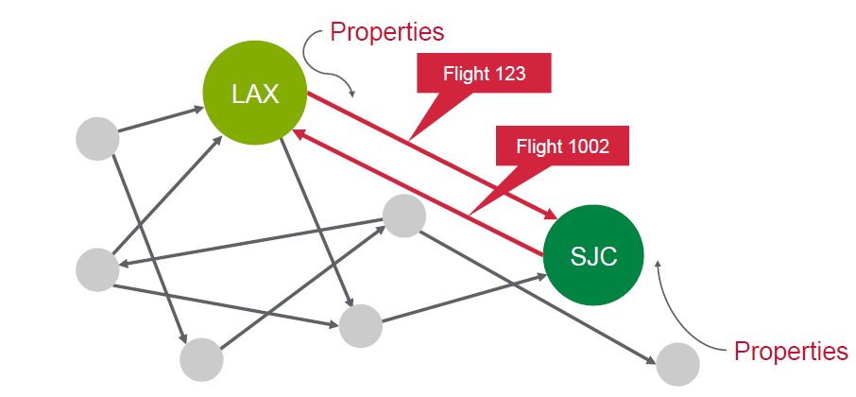
Creation of Property Graph
Create Graph
//Defining the Graph
val graph = Graph(airports, edges, nowhere)

Slide 14
Creation of Property Graph
SrcId | DestId | Property
12478 | 12892 | 2475
12892 | 11298 | 1235
11298 | 12478 | 1391
Vertex
12478
2475
1391
Edge
12892
11298
1235

Slide 15
Triplets
Triplets add the source and destination property to Edges
graph.triplets.take(3).foreach(println)
12478
2475
12478
12892
Vertices:
Edges:
12892
2475
12478
12892
Triplets:
12478, JFK | 12892,LAX | 2475
12892,LAX | 11298,DFW | 1235
11298,DFW | 12478,JFK | 1391

Slide 16
Graph Operations
Output the routes where the distance between airports exceeds 1000 miles
graph.edges.filter {
case (Edge(org_id, dest_id, distance)) => distance > 1000 }.take(5).foreach(println)

Slide 17
Graph Operations
Output the airport with maximum incoming flight
// Define a reduce operation to compute the highest degree vertex
def max: (VertexId, Int), b: (VertexId, Int)): (VertexId, Int) = {
if (a._2 > b._2) a else b
}
// Compute the max degrees
val maxInDegree: (VertexId, Int) = graph.inDegrees.reduce(max)

Slide 18
Graph Operations
Output the airports with maximum incoming flights
val maxIncoming=graph.inDegrees.collect.sortWith (_._2 > _._2).map(x => (airportMap(x._1), x._2)).take(10).foreach(println)

Slide 19
Graph Operations
Output the longest routes
graph.triplets.sortBy(_.attr, ascending = false).map(triplet =>
"There were " + triplet.attr.toString + " flights from " + triplet.srcAttr + " to " + triplet.dstAttr + ".").take(20).foreach(println)

Slide 20
Graph Operations
Output the cheapest airfare routes
val gg = graph.mapEdges(e => 50.toDouble + e.attr.toDouble / 20)
//Call pregel on graph
val sssp = initialGraph.pregel(Double.PositiveInfinity)(
//vertex program
(id, distCost, newDistCost) => math.min(distCost, newDistCost),triplet => {
//send message
if(triplet.srcAttr + triplet.attr < triplet.dstAttr)
{
Iterator((triplet.dstId, triplet.srcAttr + triplet.attr))
}

Slide 21
Graph Operations
else
{
Iterator.empty
}
},
//Merge Messages
(a,b) => math.min(a,b)
)
//print routes with lowest flight cost
print("routes with lowest flight cost")
println(sssp.edges.take(10).mkString("\n"))

Slide 22
Graph Operations (PageRank)
Output the most influential airports using PageRank
val rank = graph.pageRank(0.001).vertices
val temp = rank.join(airports)
temp.take(10).foreach(println)
Output the most influential airports from most influential to latest
val temp2 = temp.sortBy(_._2._1,false)

Slide 23

Graph Operations (PageRank)

Slide 24
Thank You

